Slide 1
SOFTWARE ENGINEERING
Software Processes

Slide 2
Software Processes
Coherent sets of activities for specifying, designing, implementing and testing software systems.
A structured set of activities required to develop a software system.
Software Process: The sequence of steps performed to produce software with high quality, within budget and schedule
Many types of activities performed by diff people in a software project
Better to view software process as comprising of many component processes

Slide 3
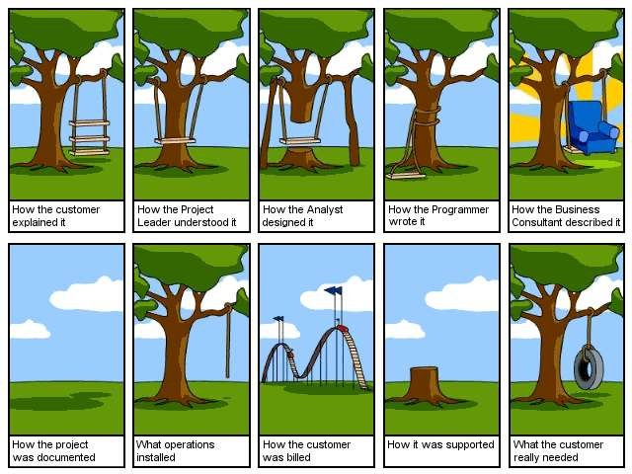
“You’ve got to be very careful if you don’t know where you’re going, because you might not get there.” - Berra

Slide 4
CMM (Capability Maturity Model)
Level 3 – Defined (< 10%)
-- peer reviews
-- intergroup coordination
-- software product engineering
-- integrated software management
-- training program
-- organization process definition
-- organization process focus
A bench-mark for measuring the maturity of an organization’s software process
CMM defines 5 levels of process maturity based on certain Key Process Areas (KPA)
Level 1 – Initial (~ 70%)
Level 2 – Repeatable (~ 15%)
-- software configuration management
-- software quality assurance
-- software project tracking and oversight
-- software project planning
-- requirements management
Level 5 – Optimizing (< 1%)
-- process change management
-- technology change management
-- defect prevention
Level 4 – Managed (< 5%)
-- software quality management
-- quantitative process management

Slide 5
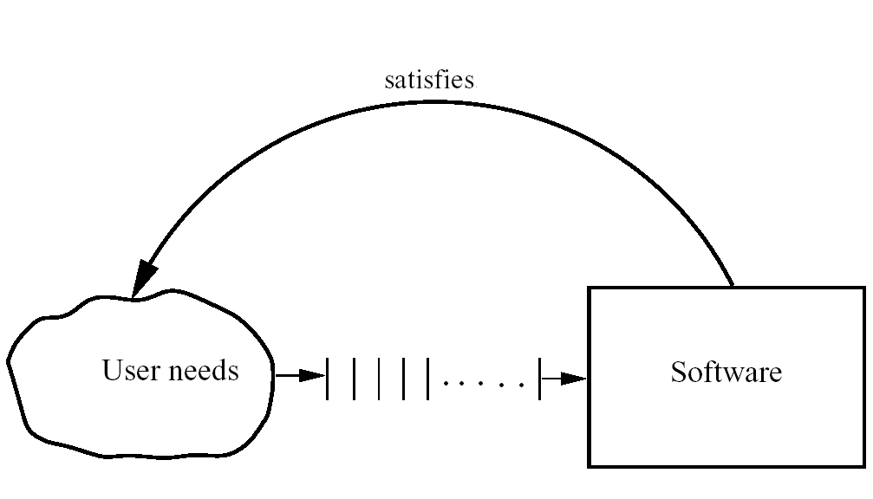
The software Development Problem
Sofware Process
5

Slide 6
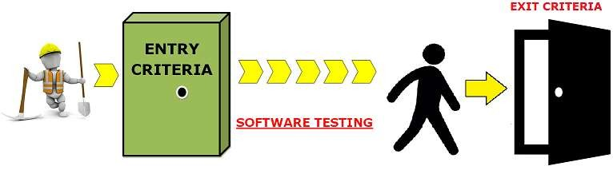
ETVX Specification
ETVX approach to specify a step
Entry criteria: what conditions must be satisfied for initiating
this phase
Task: what is to be done in this phase
Verification: the checks done on the outputs of this phase
eXit criteria: when can this phase be considered done
successfully
A phase also produces info for mgmt
Sofware Process
12

Slide 7
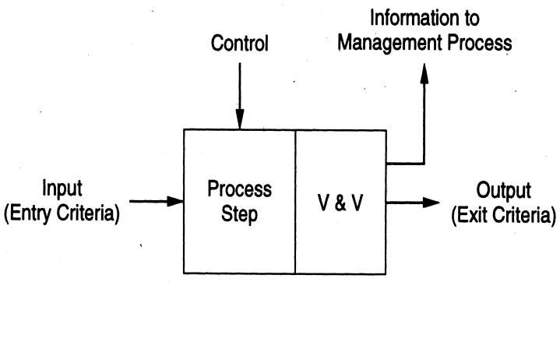
ETVX approach
Sofware Process
13

Slide 8
Development Process & Process Model
A set of phases and each phase being a sequence of steps
Sequence of steps for a phase - methodologies for that phase
Why have phases?
To employ divide and conquer
each phase handles a different part of the problem
helps in continuous validation
A process model provides generic structure of the process that can be followed by some projects to achieve their goals
Sofware Process
21

Slide 9
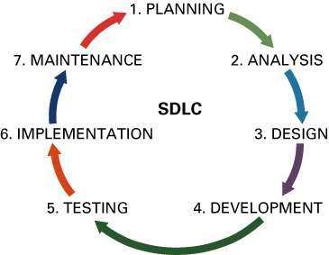
Process Models - SDLC
Major activities in SDLC (Software Development Life Cycle)
Planning
Requirements Analysis
Design
Coding
Testing
Implementation
Maintenance

Slide 10







































SDLC PHASE
ACTIVITIES
1. Planning
Define the system to be developed
Set the project scope
Develop the project plan
2. Requirements Analysis
Gather business requirements and documented in SRS
3. Design
Design the technical architecture based on SRS
Design overall system structure
4. Development
Build technical architecture, databases and programs
Build programs in small units and integrated in next phase
5. Testing
Write test conditions
Perform testing
6. Implementation/ Deployment
Write user documentation
Provide training
Product is deployed in customer environment or released to market
7. Maintenance
Build a help desk
Support Corrections, improvements and adaptations
Support system changes

Slide 11
Process Description
When we describe and discuss processes, we usually talk about the activities in these processes and the ordering of these activities.
Process descriptions may also include:
Products, which are the outcomes of a process activity;
Roles, which reflect the responsibilities of the people involved in the process;
Pre- and post-conditions, which are statements that are true before and after a process activity has been enacted or a product produced.

Slide 12
The software process Activities
A structured set of activities required to develop a software system. There are many different software processes, but all involve.
Specification - defining what the system should do
Design- defining the organization of the system and implementing the system
Validation- checking that it does what the customer wants.
Evolution- changing the system in response to changing customer needs
A software process model is an abstract representation of a process. It presents a description of a process from some particular perspective

Slide 13
Software specification
The process of establishing what services are required and the constraints on the system’s operation and development.
Requirements engineering process:
Feasibility study
Is it technically and financially feasible to build the system?
Requirements elicitation and analysis
What do the system stakeholders require or expect from the system?
Requirements specification
Defining the requirements in detail
Requirements validation
Checking the validity of the requirements

Slide 14
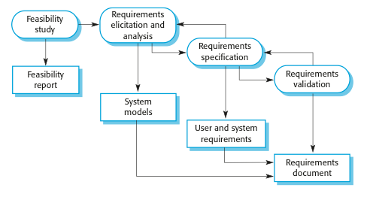
The requirements engineering process

Slide 15
Design activities
Architectural design, where you identify the overall structure of the system, the principal components (sometimes called sub-systems or modules), their relationships and how they are distributed.
Interface design, where you define the interfaces between system components.
Component design, where you take each system component and design how it will operate.
Database design, where you design the system data structures and how these are to be represented in a database.

Slide 16
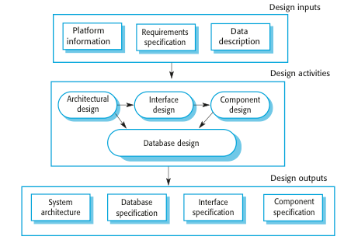
A general model of the design process

Slide 17
Software validation
Verification and validation (V & V) is intended to show that a system conforms to its specification and meets the requirements of the system customer.
Involves checking and review processes and system testing.
System testing involves executing the system with test cases that are derived from the specification of the real data to be processed by the system.

Slide 18
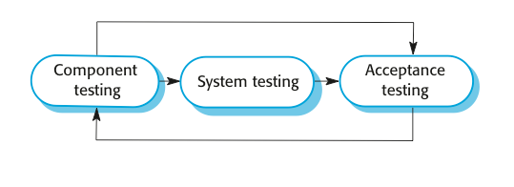
Stages of testing

Slide 19
Testing stages
Development or component testing
Individual components are tested independently;
Components may be functions or objects or coherent groupings of these entities.
System testing
Testing of the system as a whole. Testing of emergent properties is particularly important.
Acceptance testing
Testing with customer data to check that the system meets the customer’s needs.

Slide 20
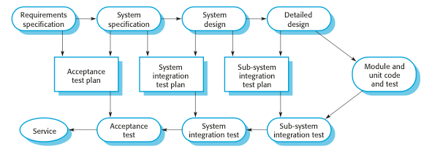
Testing phases in a plan-driven software process

Slide 21
Plan Driven & Agile Process
Plan-driven processes: are processes where all of the process activities are planned in advance and progress is measured against this plan.
In agile processes, planning is incremental and it is easier to change the process to reflect changing customer requirements.
In practice, most practical processes include elements of both plan-driven and agile approaches.
There are no right or wrong software processes.

Slide 22
Types of Process Model or Classical Model
The waterfall model
Plan-driven model. Separate and distinct phases of specification and development.
Incremental development
Specification, development and validation are interleaved. May be plan-driven or agile.
3. Reuse-oriented software engineering
The system is assembled from existing components. May be plan-driven or agile.
In practice, most large systems are developed using a process that incorporates elements from all of these models.

Slide 23
Waterfall model

Slide 24
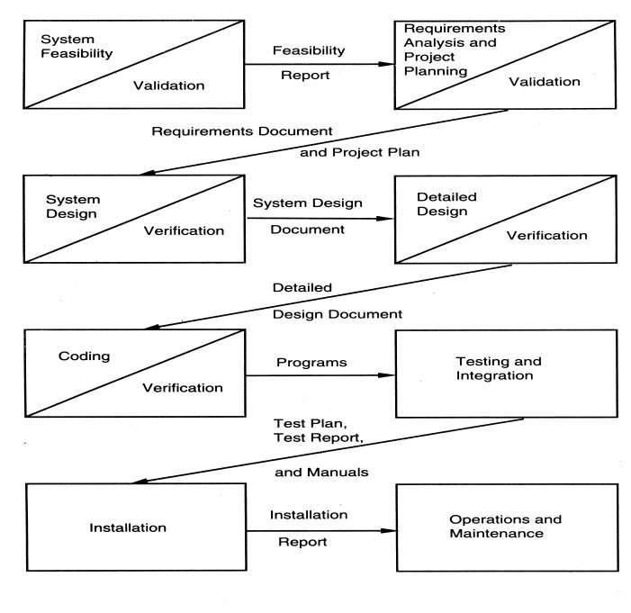
Sofware Process
25

Slide 25
Waterfall Advantages
Easy to understand, easy to use
Provides structure to inexperienced staff
Milestones are well understood
Sets requirements stability
Good for management control (plan, staff, track)
Works well when quality is more important than cost or schedule
Sofware Process
28

Slide 26
Waterfall disadvantages
All requirements must be known upfront
Follows the “big bang” approach – all or nothing delivery; too risky
Very document oriented, requiring docs at the end of each phase
Views software development as manufacturing process rather than as creative process
No iterative activities and Change Management that lead to creating a final product
Long wait before a final product
Sofware Process
29

Slide 27
Waterfall Usage
Has been used widely
Well suited for projects where requirements can be understood easily and technology decisions are easy
For familiar type of projects with well known requirements
Sofware Process
30

Slide 28
Waterfall model phases
Requirements analysis and definition
System and software design
Implementation and unit testing
Integration and system testing
Operation and maintenance
The drawback of the waterfall model is the difficulty of accommodating change after the process is underway

Slide 29
Waterfall model problems
The main drawback of the waterfall model is the difficulty of accommodating change after the process is underway. In principle, a phase has to be complete before moving onto the next phase.
Inflexible partitioning of the project into distinct stages makes it difficult to respond to changing customer requirements.
Therefore, this model is only appropriate when the requirements are well-understood and changes will be fairly limited during the design process.
Few business systems have stable requirements.
The waterfall model is mostly used for large systems engineering projects where a system is developed at several sites.
In those circumstances, the plan-driven nature of the waterfall model helps coordinate the work.

Slide 30
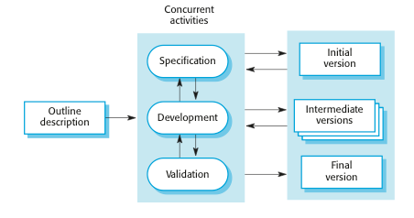
Incremental development

Slide 31
Incremental development Advantages
The cost of accommodating changing customer requirements is reduced.
The amount of analysis and documentation that has to be redone is much less than is required with the waterfall model.
It is easier to get customer feedback on the development work that has been done.
Customers can comment on demonstrations of the software and see how much has been implemented.
More rapid delivery and deployment of useful software to the customer is possible.
Customers are able to use and gain value from the software earlier than is possible with a waterfall process.

Slide 32
Incremental Development Problems
The process is not visible.
Managers need regular deliverables to measure progress. If systems are developed quickly, it is not cost-effective to produce documents that reflect every version of the system.
System structure tends to degrade as new increments are added.
Unless time and money is spent on refactoring to improve the software, regular change tends to corrupt its structure.
Incorporating further software changes becomes increasingly difficult and costly.

Slide 33
Evolutionary Process
Exploratory development
Objective is to work with customers and to evolve a final system from an initial outline specification. Should start with well-understood requirements
Throw-away prototyping
Objective is to understand the system requirements. Should start with poorly understood requirements

Slide 34
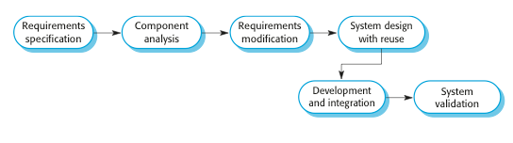
Reuse Oriented Development

Slide 35
Reuse-based Software Engineering
Based on systematic reuse where systems are integrated from existing components or COTS (Commercial-off-the-shelf) systems.
Process stages
Component analysis
Requirements modification
System design with reuse
Development and integration
Reuse is now the standard approach for building many types of business system

Slide 36
Coping with change
Change is predictable in all large software projects.
Business changes lead to new and changed system requirements
New technologies open up new possibilities for improving implementations
Changing platforms require application changes
Change leads to rework so the costs of change include both rework (e.g. re-analyzing requirements) as well as the costs of implementing new functionality

Slide 37
Reducing the costs of rework
Change avoidance: where the software process includes activities that can anticipate possible changes before significant rework is required.
For example, a prototype system may be developed to show some key features of the system to customers.
Change tolerance: where the process is designed so that changes can be accommodated at relatively low cost.
This normally involves some form of incremental development. Proposed changes may be implemented in increments that have not yet been developed. If this is impossible, then only a single increment (a small part of the system) may have be altered to incorporate the change.

Slide 38
Software prototyping
A prototype is an initial version of a system used to demonstrate concepts and try out design options.
A prototype can be used in:
The requirements engineering process to help with requirements elicitation (gathering) and validation;
In design processes to explore options and develop a UI design;

Slide 39
Benefits of prototyping
Improved system usability.
A closer match to users’ real needs.
Improved design quality.
Improved maintainability.
Reduced development effort.

Slide 40
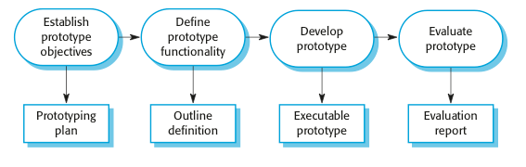
The process of prototype development

Slide 41
Prototype development
May be based on rapid prototyping languages or tools.
May involve leaving out functionality.
Prototype should focus on areas of the product that are not well-understood;
Error checking and recovery may not be included in the prototype;
Focus on functional rather than non-functional requirements such as reliability and security.

Slide 42
Throw-away prototypes
Prototypes should be discarded after development as they are not a good basis for a production system:
It may be impossible to tune the system to meet non-functional requirements;
Prototypes are normally undocumented;
The prototype structure is usually degraded through rapid change;
The prototype probably will not meet normal organizational quality standards.

Slide 43
Incremental delivery
Rather than deliver the system as a single delivery, the development and delivery is broken down into increments with each increment delivering part of the required functionality.
User requirements are prioritised and the highest priority requirements are included in early increments.
Once the development of an increment is started, the requirements are frozen though requirements for later increments can continue to evolve.

Slide 44
Incremental development and delivery
Incremental development
Develop the system in increments and evaluate each increment before proceeding to the development of the next increment;
Normal approach used in agile methods;
Incremental delivery
Deploy an increment for use by end-users;
More realistic evaluation about practical use of software;
Difficult to implement for replacement systems as increments have less functionality than the system being replaced.

Slide 45
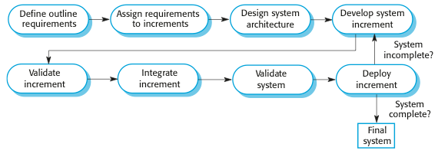
Incremental delivery

Slide 46
Incremental delivery advantages
Customer value can be delivered with each increment so system functionality is available earlier.
Early increments act as a prototype to help extract requirements for later increments.
Lower risk of overall project failure.
The highest priority system services tend to receive the most testing.

Slide 47
Incremental delivery problems
Most systems require a set of basic facilities that are used by different parts of the system.
As requirements are not defined in detail until an increment is to be implemented, it can be hard to identify common facilities that are needed by all increments.
The essence of iterative processes is that the specification is developed in conjunction with the software.
However, this conflicts with the procurement model of many organizations, where the complete system specification is part of the system development contract.

Slide 48
Boehm’s spiral model
Process is represented as a spiral rather than as a sequence of activities with backtracking.
Each loop in the spiral represents a phase in the process.
No fixed phases such as specification or design - loops in the spiral are chosen depending on what is required.
Risks are explicitly assessed and resolved throughout the process.

Slide 49
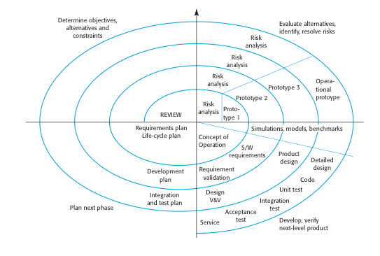
Boehm’s spiral model of the software process

Slide 50
Spiral model sectors
Objective setting
Specific objectives for the phase are identified.
Risk assessment and reduction
Risks are assessed and activities put in place to reduce the key risks.
Development and validation
A development model for the system is chosen.
Planning
The project is reviewed and the next phase of the spiral is planned.

Slide 51
Spiral model usage
Spiral model has been very influential in helping people think about iteration in software processes and introducing the risk-driven approach to development.
In practice, however, the model is rarely used as published for practical software development.

Slide 52
The Rational Unified Process
A modern generic process derived from the work on the UML and associated process.
Normally described from three perspectives:
A dynamic perspective that shows phases over time;
A static perspective that shows process activities;
A practice perspective that suggests good practice.

Slide 53
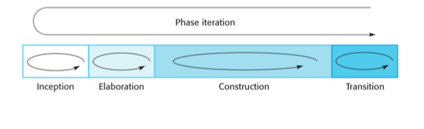
Phases in the Rational Unified Process

Slide 54
RUP phases
Inception
Establish the business case for the system.
Elaboration
Develop an understanding of the problem domain and the system architecture.
Construction
System design, programming and testing.
Transition
Deploy the system in its operating environment.

Slide 55
RUP iteration
In-phase iteration
Each phase is iterative with results developed incrementally.
Cross-phase iteration
As shown by the loop in the RUP model, the whole set of phases may be enacted incrementally.

Slide 56
Static workflows in the Rational Unified Process
Workflow | Description
Business modelling | The business processes are modelled using business use cases.
Requirements | Actors who interact with the system are identified and use cases are developed to model the system requirements.
Analysis and design | A design model is created and documented using architectural models, component models, object models and sequence models.
Implementation | The components in the system are implemented and structured into implementation sub-systems. Automatic code generation from design models helps accelerate this process.

Slide 57
Static workflows in the Rational Unified Process
Workflow | Description
Testing | Testing is an iterative process that is carried out in conjunction with implementation.
Deployment | A product release is created, distributed to users and installed in their workplace.
Configuration and change management | This supporting workflow managed changes to the system.
Project management | This supporting workflow manages the system development.
Environment | This workflow is concerned with making appropriate software tools available to the software development team.

Slide 58
RUP good practice
Develop software iteratively
Plan increments based on customer priorities and deliver highest priority increments first.
Manage requirements
Explicitly document customer requirements and keep track of changes to these requirements.
Use component-based architectures
Organize the system architecture as a set of reusable components.

Slide 59
RUP good practice
Visually model software
Use graphical UML models to present static and dynamic views of the software.
Verify software quality
Ensure that the software meet’s organizational quality standards.
Control changes to software
Manage software changes using a change management system and configuration management tools.

Slide 60
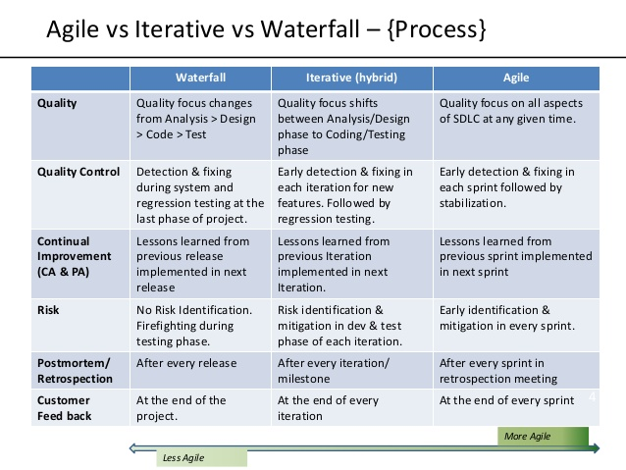

Slide 61
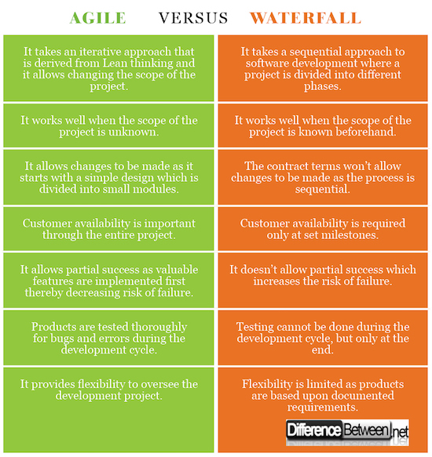

Slide 62
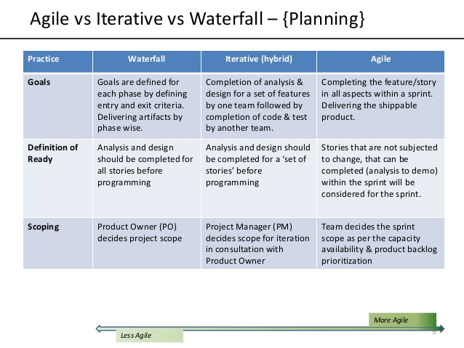

Slide 63
